Slide 1
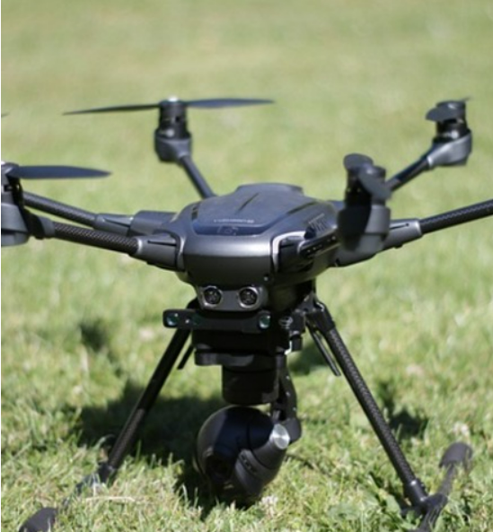
Autonomous Drone Fleet For Missing Child Rescue
Team Members:
R. SandeepReddy 20R21A6645
V.Sravankumar 20R21A6654
Md.Owais 20R21A6639
Tharuni 20R21A6623
Guide name: Mr. J.Vijay Gopal

Slide 2
INTRODUCTION
The "Autonomous drone fleet for missing child rescue " project aims to develop a fleet of autonomous drones equipped with advanced sensors for efficient and safe navigation through forest areas. These drones will play a pivotal role in finding the child, giving the postion of the child to rescue team.

Slide 3

Challenge Scenario
Imagine a family outing in a vast and densely wooded forest. Amid the excitement and natural beauty, a child suddenly goes missing. Panic sets in as the family and local authorities realize the child's vulnerability in the unfamiliar and potentially hazardous environment. Traditional search methods are immediately launched, involving ground teams and volunteers scouring the forest on foot. However, the dense undergrowth, uneven terrain, and limited visibility make progress slow and fraught with challenges.
Fast Communication and Coordination

Slide 4
Objectives
Rapid Search and Rescue
Autonomous Operation
Multi-Sensor Integration
Communication and Collaboration
Real-time Data Analysis
Safety and Reliability

Slide 5
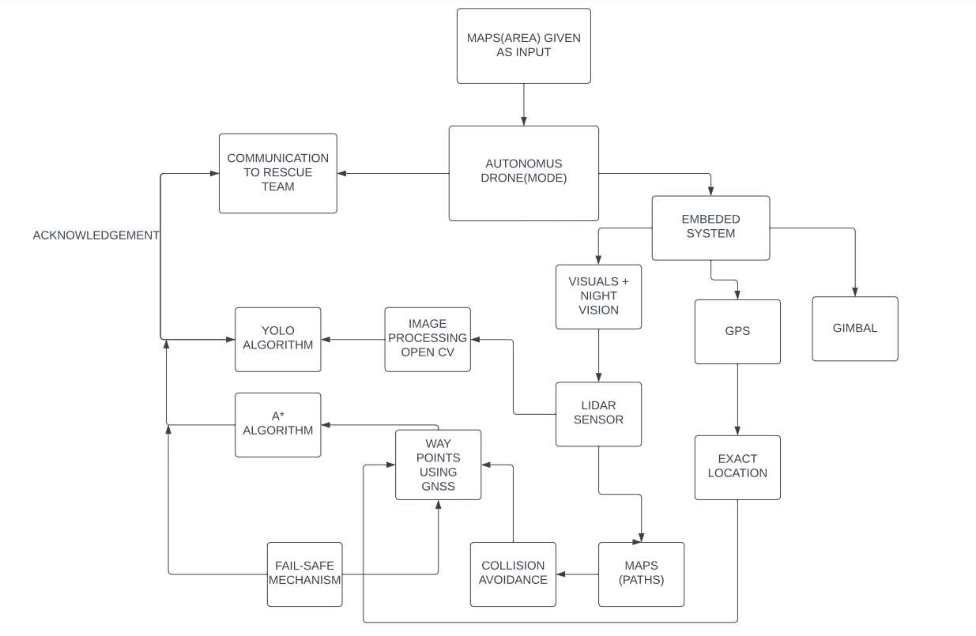
Architecture

Slide 6
Obstacle Detection
creating the grid-map using LIDAR
Finding the obstacles
Plotting in the grid-map

Slide 7
Autonomous navigation
Waypoints using GNSS
A* algorithm
Fail safe mechanism

Slide 8
Image processing
Image processing
YOLO Algorithm

Slide 9
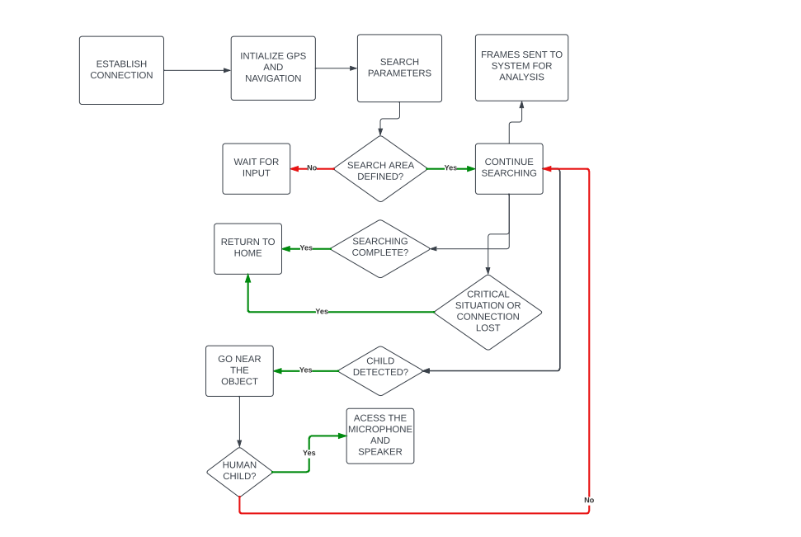
Communication

Slide 10
Drawbacks
Vast and Unpredictable Terrain
Human intervention in unpredictable situations
Loss of communication between the drone and the rescue team
Adverse weather conditions

Slide 11
CONCLUSION
In conclusion, the implementation of an autonomous drone fleet for missing child rescue holds significant potential to revolutionize search and rescue operations. By leveraging advanced imaging technology, AI algorithms, and real-time data transmission, these drones can cover expansive areas efficiently, locate individuals in challenging terrains, and provide vital information to rescue teams. The use of autonomous drones not only enhances the speed and accuracy of search efforts but also maximizes the chances of a successful outcome in critical situations involving missing children. As technology continues to advance, the integration of such drone fleets could become a crucial tool in safeguarding the well-being of our communities and reuniting families in times of distress

Slide 12


